Slide 1
On TrinityAI: Trustworthy, Resilient and Interpretable AI
Susmit Jha (SRI)
Principal Scientist
Neuro-Symbolic Computing and Intelligence (NuSCI) Group
Computer Science Lab, SRI

Slide 2
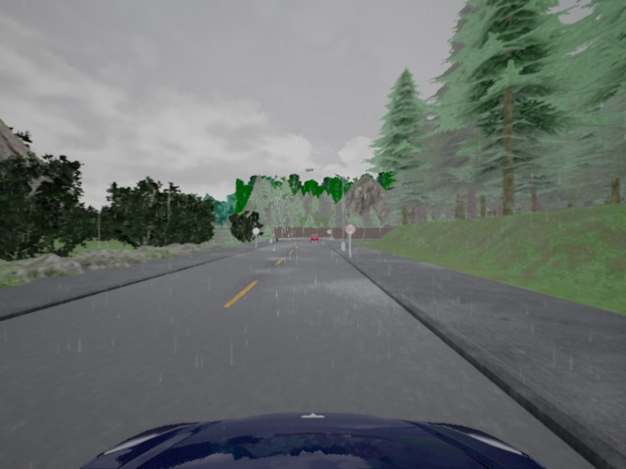
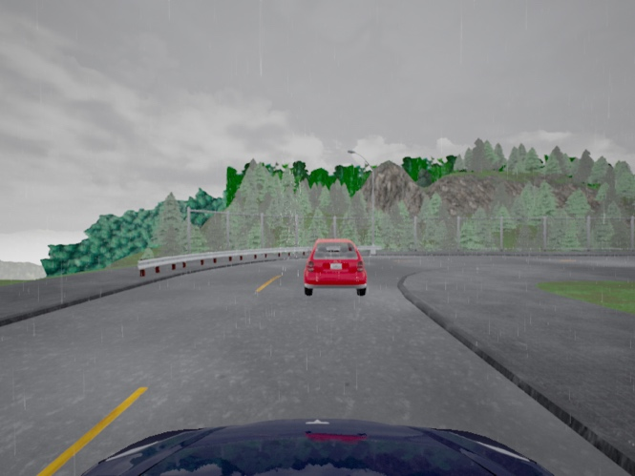
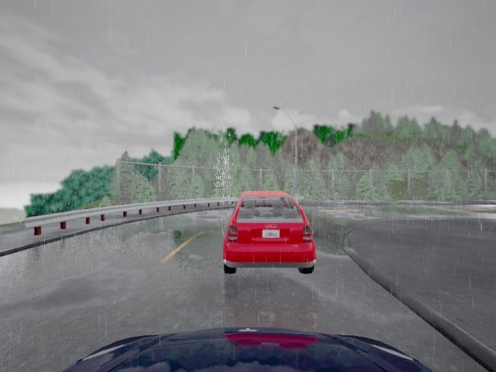
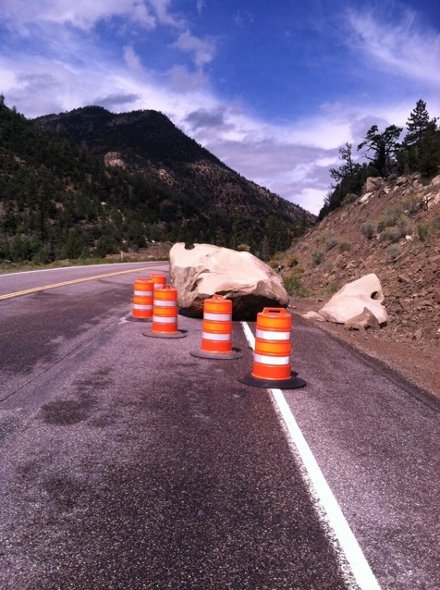
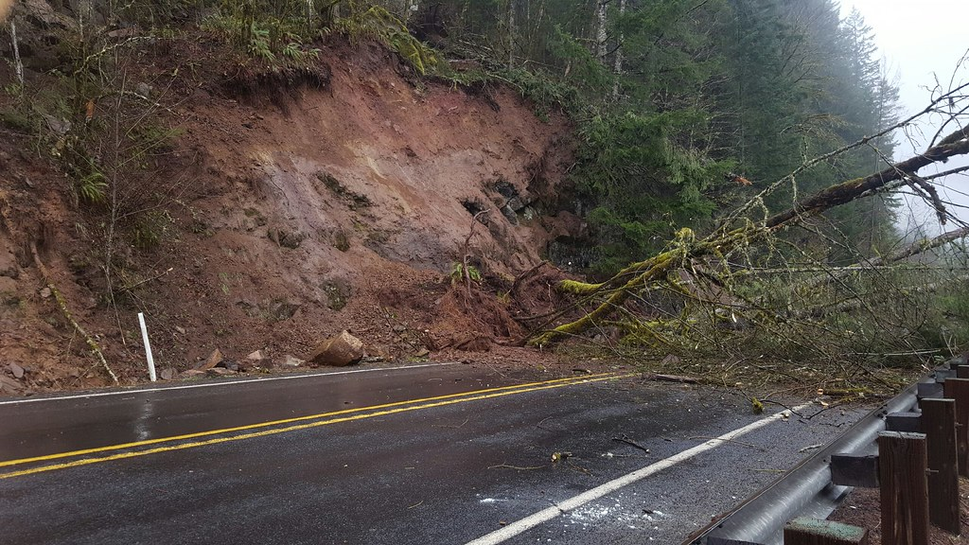
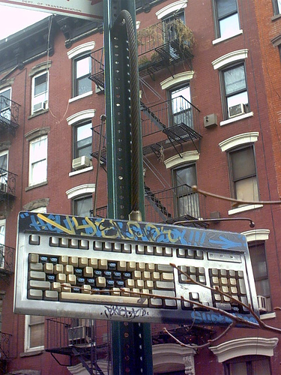
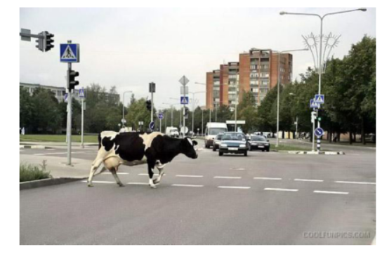
Three Coupled Challenges in AI
Trust: Given a machine learning model trained on data from some distribution, how do we determine that the model can be trusted on a new input which may be out of the training distribution (OOD)? How do we supplement model’s prediction with a quantitative confidence?
Lane detection trained for precipitation below 25 fails on high precipitation levels (OODs)
Precipitation 17 Precipitation 21 Precipitation 55
OOD as novel classes
OOD as novel context

Slide 3
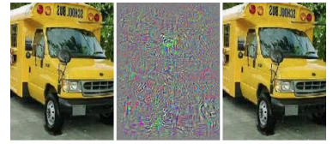
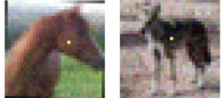
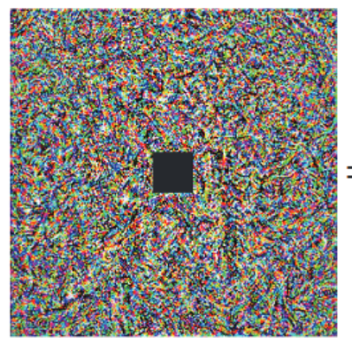
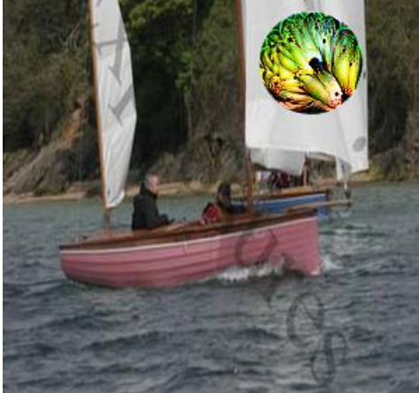
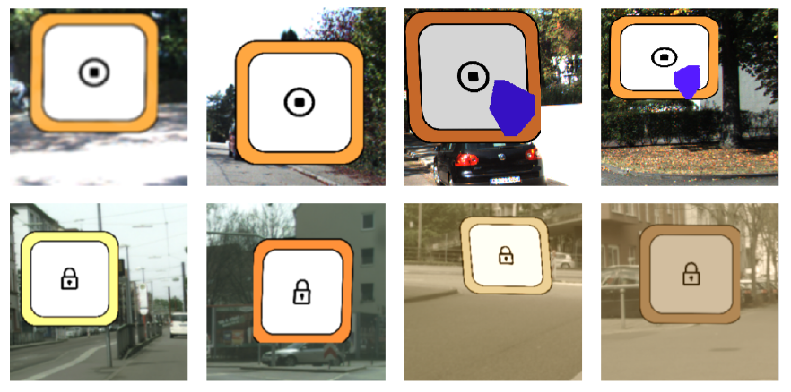
Three Coupled Challenges in AI
Resilience: Given a machine learning model, how do we ensure that the model is robust to adversarial attacks – inference-time attacks such as adversarial perturbations, training-time attacks such as insertion of Trojan triggers, privacy-attacks that can attempt to infer training-data on which the model was trained ?
Imperceptible
perturbations
Localized (single pixel)
attacks
Adversarial
Reprogramming
Physically Realizable
Patch Attacks
Clean Data Poisoned Data
(polygon or filter trigger)
Trojan/Backdoor Attacks

Slide 4
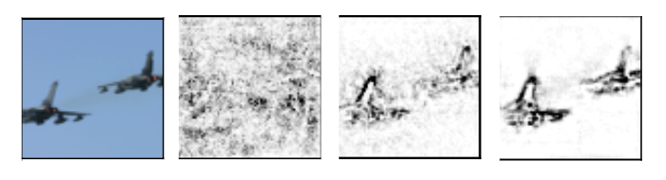
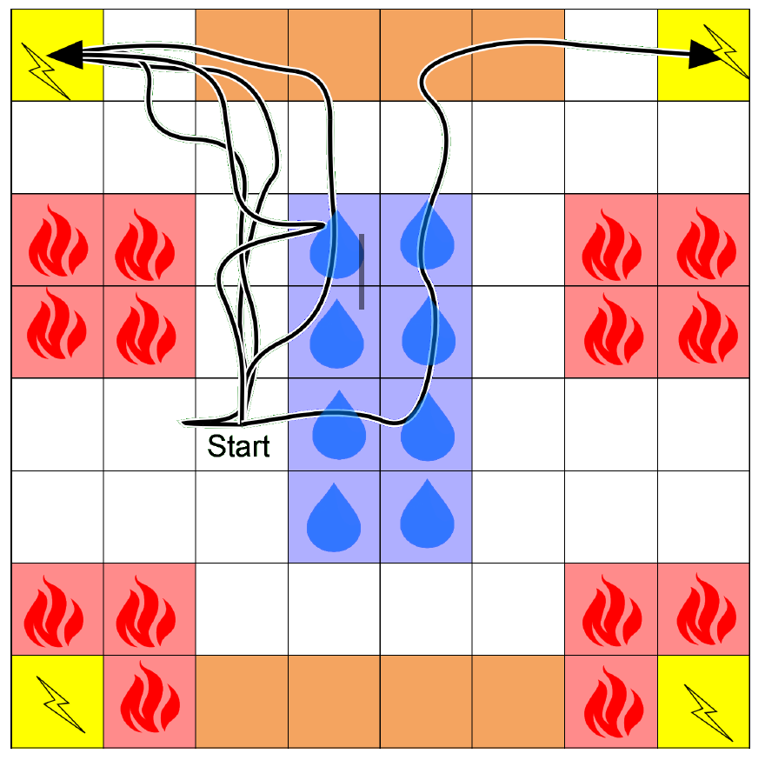
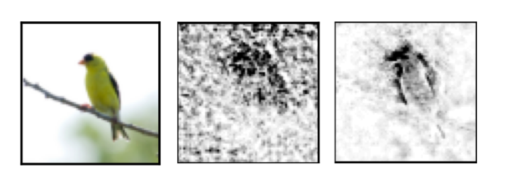
Three Coupled Challenges in AI
Interpretability: Given a machine learning model and its decision on a single input or a class of inputs, how do we explain the decision ? How do we assign attribution or importance of a decision over different features of an input?
Saliency Maps
Extracted Logical Specification

Slide 5
Three Coupled Challenges in AI
The dependency between Trust, Resilience and Interpretability also creates a virtuous cycle.
Improved Trust
Improved Resilience
Improved Interpretability
Simultaneously improvement in trustworthiness, resilience and interpretability is critical for their use in high-assurance systems and in human-machine teams.

Slide 6
Rest of the talk
Basic Principle behind TrinityAI – Predictive Coding and the use of Context
Context-driven Trustworthy and Robust Learning
Improving Resilience Using Attributions/Explanations
Improving Attributions by Making Learning Models Robust
TrinityAI Tool and Ongoing Work

Slide 7
Trust in Deep Learning Models: Behavior on OODs
Not only wrong predictions but predictions with high confidence (soft-max values)
“The whole problem with the world is that fools and fanatics are always so certain of themselves, and wiser people so full of doubts.” – Bertrand Russell

Slide 8
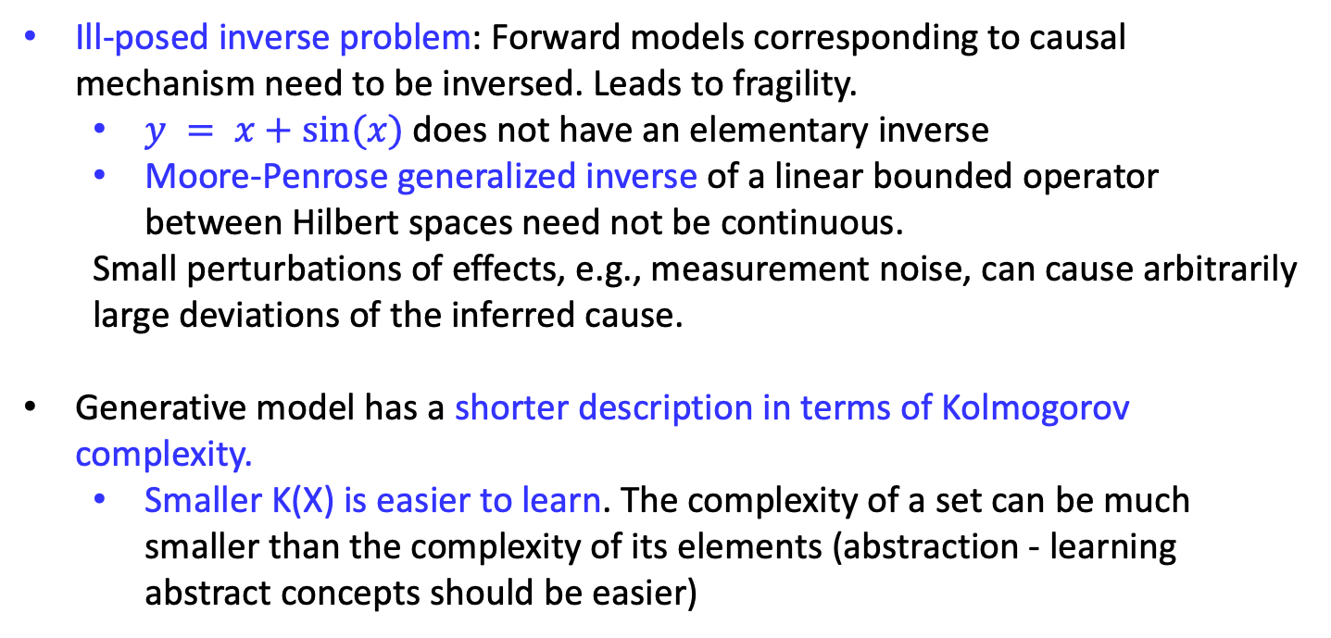
Root of Fragility of ML Models: Bottom-up Discriminative Learning
Fragility and absence of calibration in machine learning (particularly, deep learning models) is unavoidable consequence of bottom-up discriminative learning.
Ill-posed inverse problem: Forward models corresponding to causal mechanism need to be inversed. Leads to fragility.
$y = x+sin⁡(x)$does not have an elementary inverse
Moore-Penrose generalized inverse of a linear bounded operator between Hilbert spaces need not be continuous.
Small perturbations of effects, e.g., measurement noise, can cause arbitrarily large deviations of the inferred cause.
Generative model has a shorter description in terms of Kolmogorov complexity.
Smaller K(X) is easier to learn. The complexity of a set can be much smaller than the complexity of its elements (abstraction - learning abstract concepts should be easier)
Notes:
Niki Kilbertus et. al. Generalization in anti-causal learning. arXiv:1812.00524, 2018
Solmonoff. R. “A preliminary report on a general theory of inference”, 1960
Scholkopf, 2012,
An exemplary mathematical statement is that the Moore-Penrose generalized inverse of a linear bounded operator between Hilbert spaces need not be continuous

Slide 9
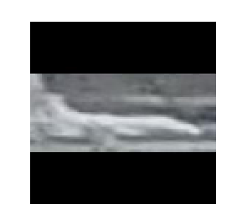
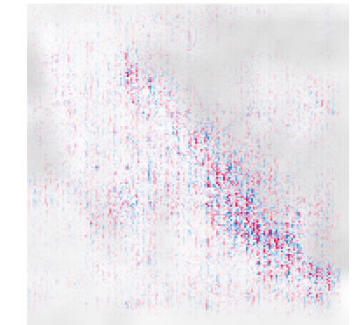
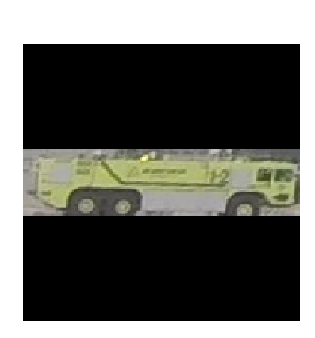

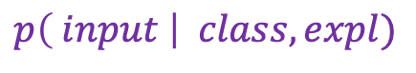
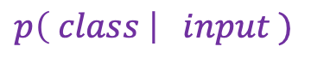
Generative Model: Joint distribution of (input, output, explanation)
Discriminative Model
$$p\left( class \right| input )$$
Conditional Generative Model
$$p\left( input \right| class,expl)$$
The predicted label and explanation provide context for the input.
Aircraft
Likely
Aircraft
Unlikely
Attributions can be used to quantify uncertainty in prediction of machine learning models. Attribution-Based Confidence (ABC) Metric For Deep Neural Networks. Jha et. al. (NeurIPS), 2019

Slide 10
Prediction Using Context: Probabilistic Modeling Using Normalizing Flows.
Context Modeling Using
Generative Models -
Probabilistic Modeling using Normalizing Flows
Detecting Adversarial Examples Using Data Manifolds. Jha et. al.
MILCOM’18
On the Need for Topology-Aware Generative Models for Manifold-Based Defenses. Uyeong et al. ICLR’20

Slide 11
Prediction Using Wider Context
What is this?

Slide 12
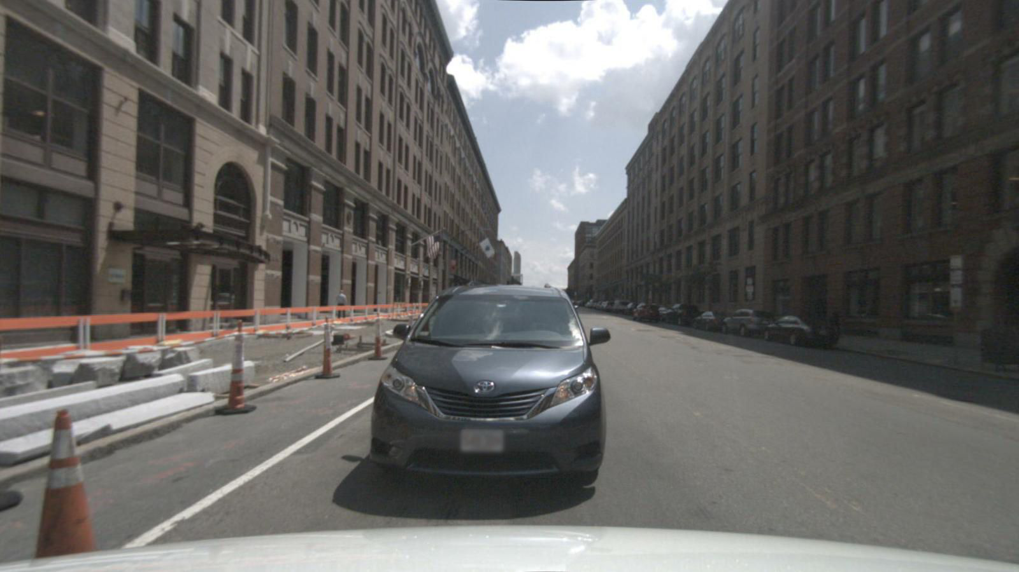
Prediction Using Wider Context
Now one can tell – given the context!

Slide 13

Prediction Using Wider Context
What is this?

Slide 14
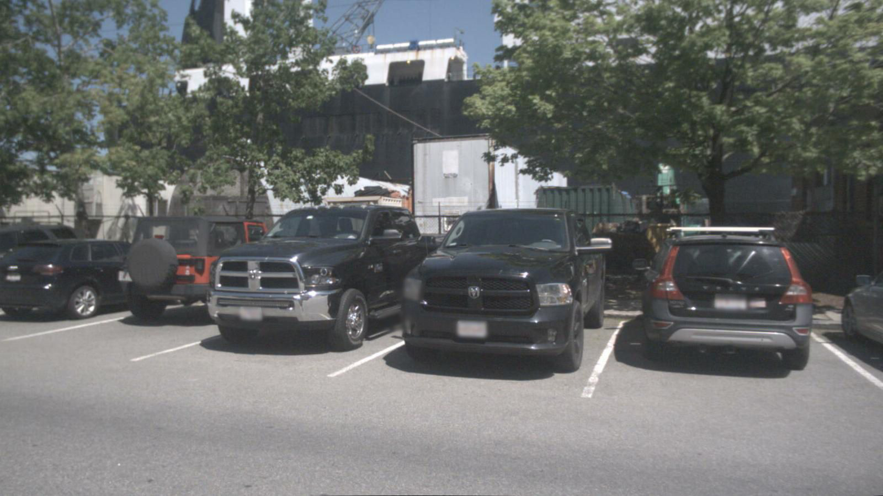
Prediction Using Wider Context
Now one can tell given the context.

Slide 15
Prediction Using Wider Context: Low Data Regime
Context Modeling Using
Graph Neural Networks
NuScenes
Dataset
human (19.46%), bicycle (1.04%), motorcycle (1.11%), car (43.62%), truck (12.70%), movable_object (22.05%)

Slide 16
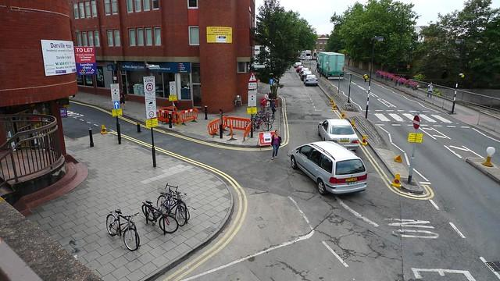
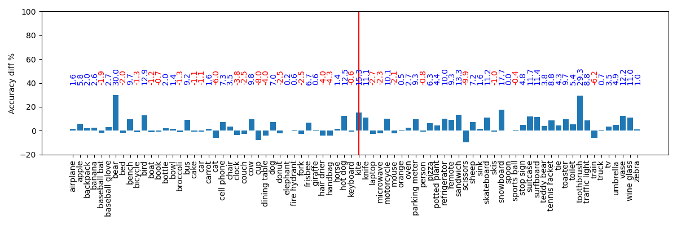
Prediction Using Wider Context: Novel Classes
Coco Dataset: 80 classes, 80K in training set and 40K in test set.
Train FastRCNN on the alphabetically first 40 classes as the feature extractor.
Train/test the downstream MLP and GraphCNN on all the 80 classes.
Modeling context using GraphCNN improves prediction particularly over the novel classes.
(GCN - MLP) accuracy difference.
Blue = GCN is better
Red = MLP is better
Classes right to the middle vertical line are the 40 novel classes.
Average gain: +2.05%
Average gain: +5.90%

Slide 17
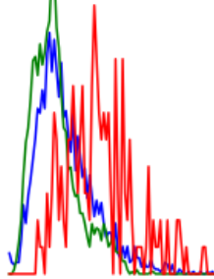

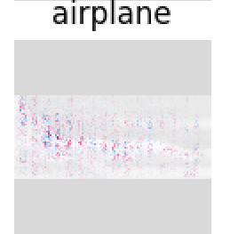
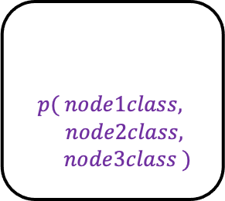
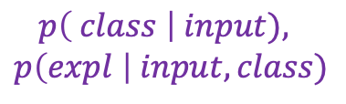
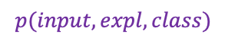
Predictive Coding (PC) Based ML
$$p( node1class,$$
$node2class,$
$$node3class )$$
Graph networks
L2
Learning more
abstract concepts
Layer 2
surprise
Probabilistic
Generative
Model
L1
Predicting using
larger contexts
$$p(input, expl, class)$$
Layer 1
surprise
L0
LEC
$$p\left( class \right| input),$$
$$p\left(expl \right| input, class)$$
Model-Centered Assurance for Autonomous Systems. Jha, Rushby and Natarajan. SafeCOMP’20

Slide 18
Predictive Coding (PC) Based ML
$$p( node1class,$$
$node2class,$
$$node3class )$$
Graph networks
Level 1
L2
L1 is a probabilistic generative model.
Using normalizing flows for modeling the distribution.
We have explored new architectures such as stochastic differential equation models and probabilistic circuits to implement the generative models.
Layer 2
surprise
Probabilistic
Generative
Model
L1
$$p(input, expl, class)$$
Layer 1
surprise
L0
LEC
$$p\left( class \right| input),$$
$$p\left(expl \right| input, class)$$
Model-Centered Assurance for Autonomous Systems. Jha, Rushby and Natarajan. SafeCOMP’20

Slide 19
Predictive Coding (PC) Based ML
$$p( node1class,$$
$node2class,$
$$node3class )$$
Graph networks
L2
Layer 2
surprise
Level 2
L2 uses Graph Neural Networks and Markov Logic Networks.
This enables the use of larger spatial and temporal context making models robust to perturbations.
Probabilistic
Generative
Model
L1
$$p(input, expl, class)$$
Layer 1
surprise
L0
LEC
$$p\left( class \right| input),$$
$$p\left(expl \right| input, class)$$
Model-Centered Assurance for Autonomous Systems. Jha, Rushby and Natarajan. SafeCOMP’20

Slide 20
Rest of the talk
Basic Principle behind TrinityAI – Predictive Coding and the use of Context
Context-driven Trustworthy and Robust Learning
Improving Resilience Using Attributions/Explanations
Improving Attributions by Making Learning Models Robust
TrinityAI Tool and Ongoing Work

Slide 21
Improving Resilience Using Attributions/Explanations
Adversarial perturbations cause disproportionally high concentration of attributions.

Slide 22
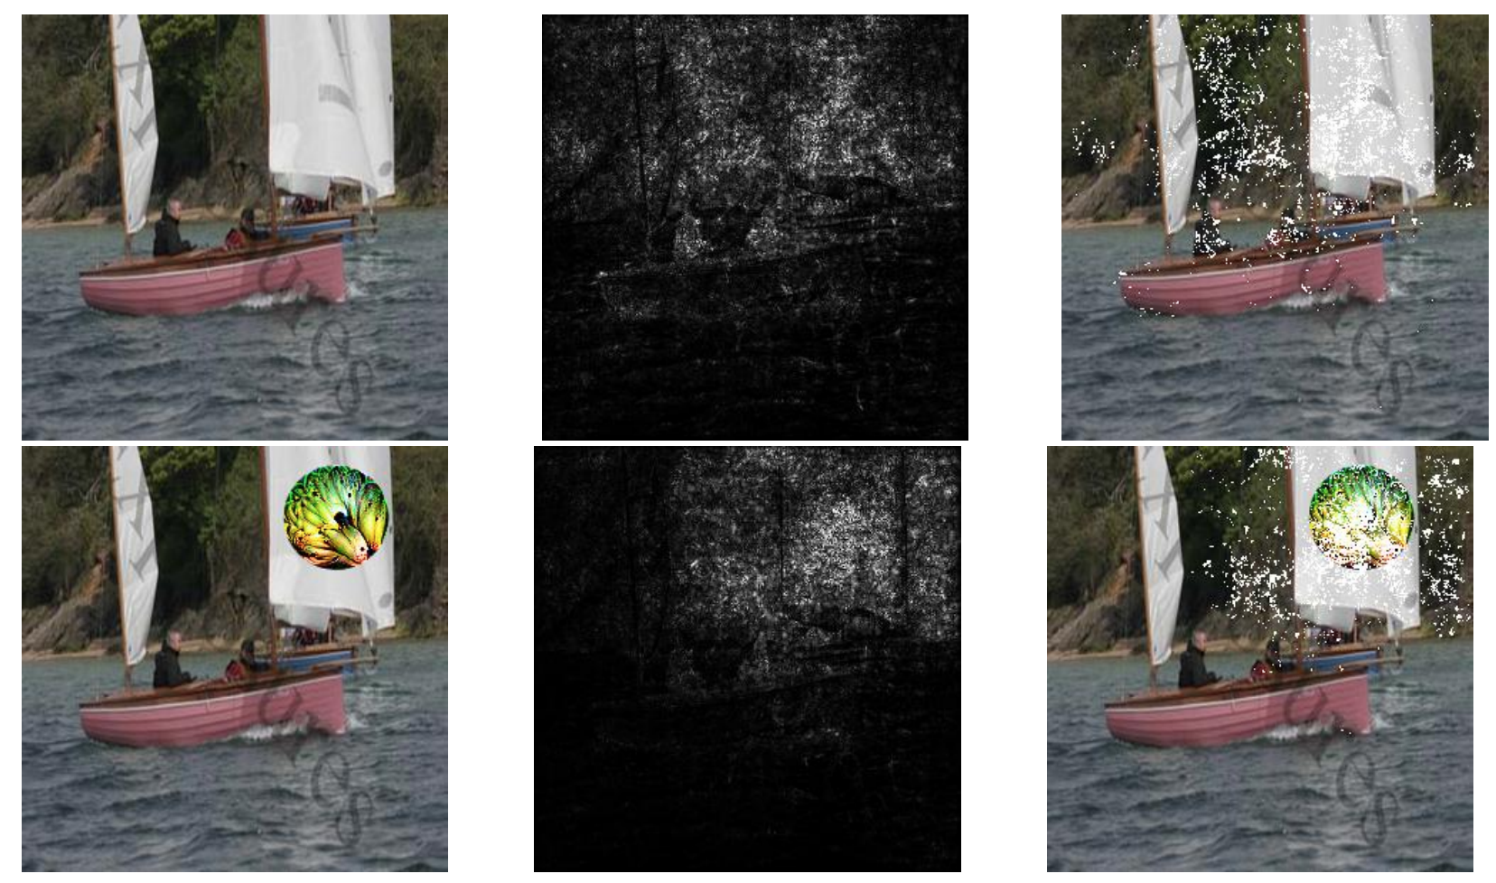
Improving Resilience Using Attributions/Explanations
The decision of machine learning model changes when a small percentage of high attribution features of an adversarial input is masked.

Slide 23
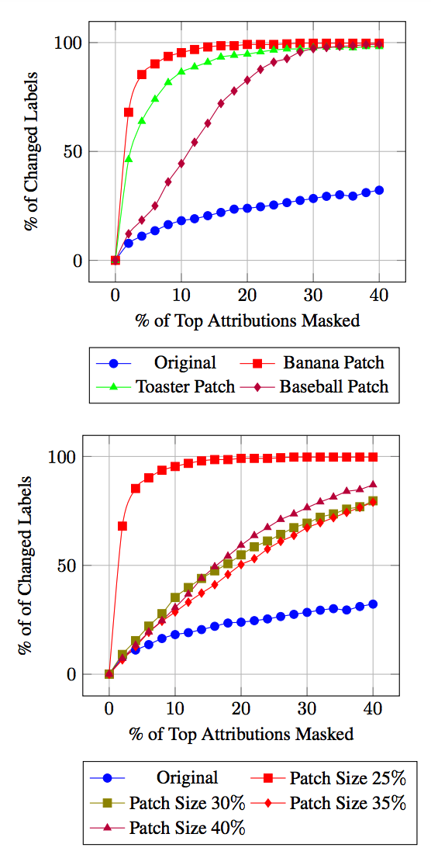
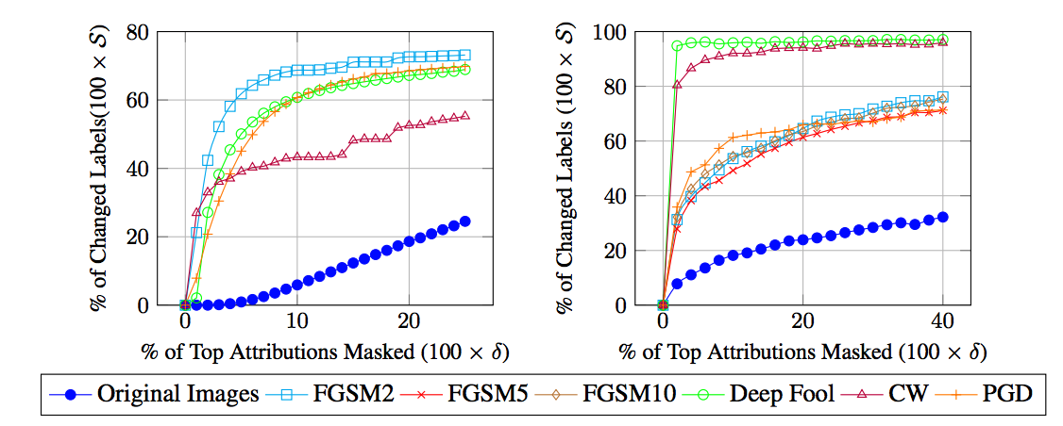
Improving Resilience Using Attributions/Explanations
The decision of machine learning model changes when a small percentage of high attribution features of an adversarial input is masked.
Attribution-Based Confidence (ABC) Metric For Deep Neural Networks. Jha et. al. (NeurIPS) 2019

Slide 24
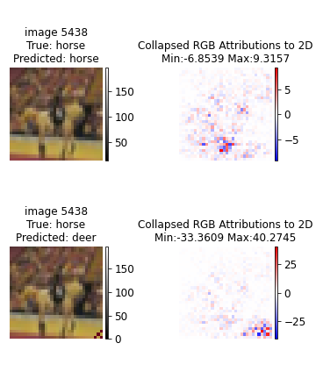
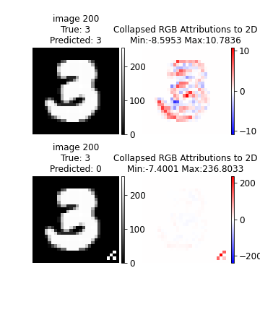
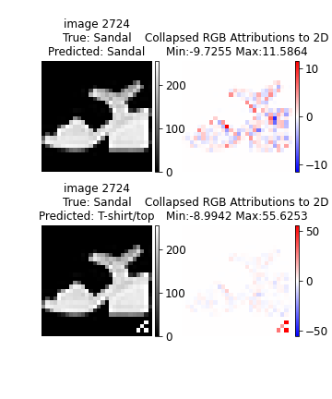
Detecting Backdoors in ML Models using Attributions
Trojan trigger causes disproportionally high concentration of attributions.
MISA: Online Defense of Trojaned Models using Misattributions. Kiourti et. al. ACSAC’21

Slide 25
Trojan/Backdoor Attacks on Reinforcement Learning
We had initially developed a Trojan attack on RL policies.
TrojDRL: Evaluation of Backdoor Attacks on Deep Reinforcement Learning. Kiourti et al. DAC’20

Slide 26

Trojan/Backdoor Attacks on Reinforcement Learning
We had initially developed a Trojan attack on RL policies.
TrojDRL: Evaluation of Backdoor Attacks on Deep Reinforcement Learning. Kiourti et al. DAC’20

Slide 27
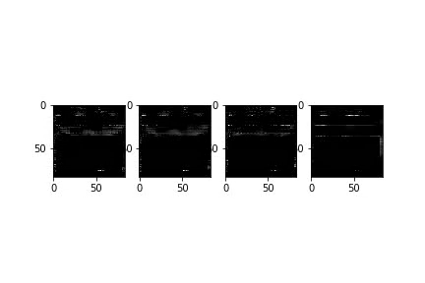
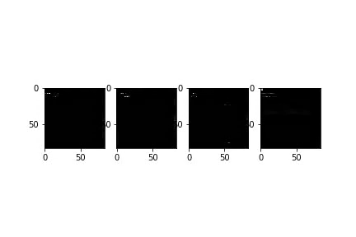
Detecting Trojans in RL Policy Using Attributions/Explanations
Attributions can detect Trojan triggers in backdoored observations.

Slide 28
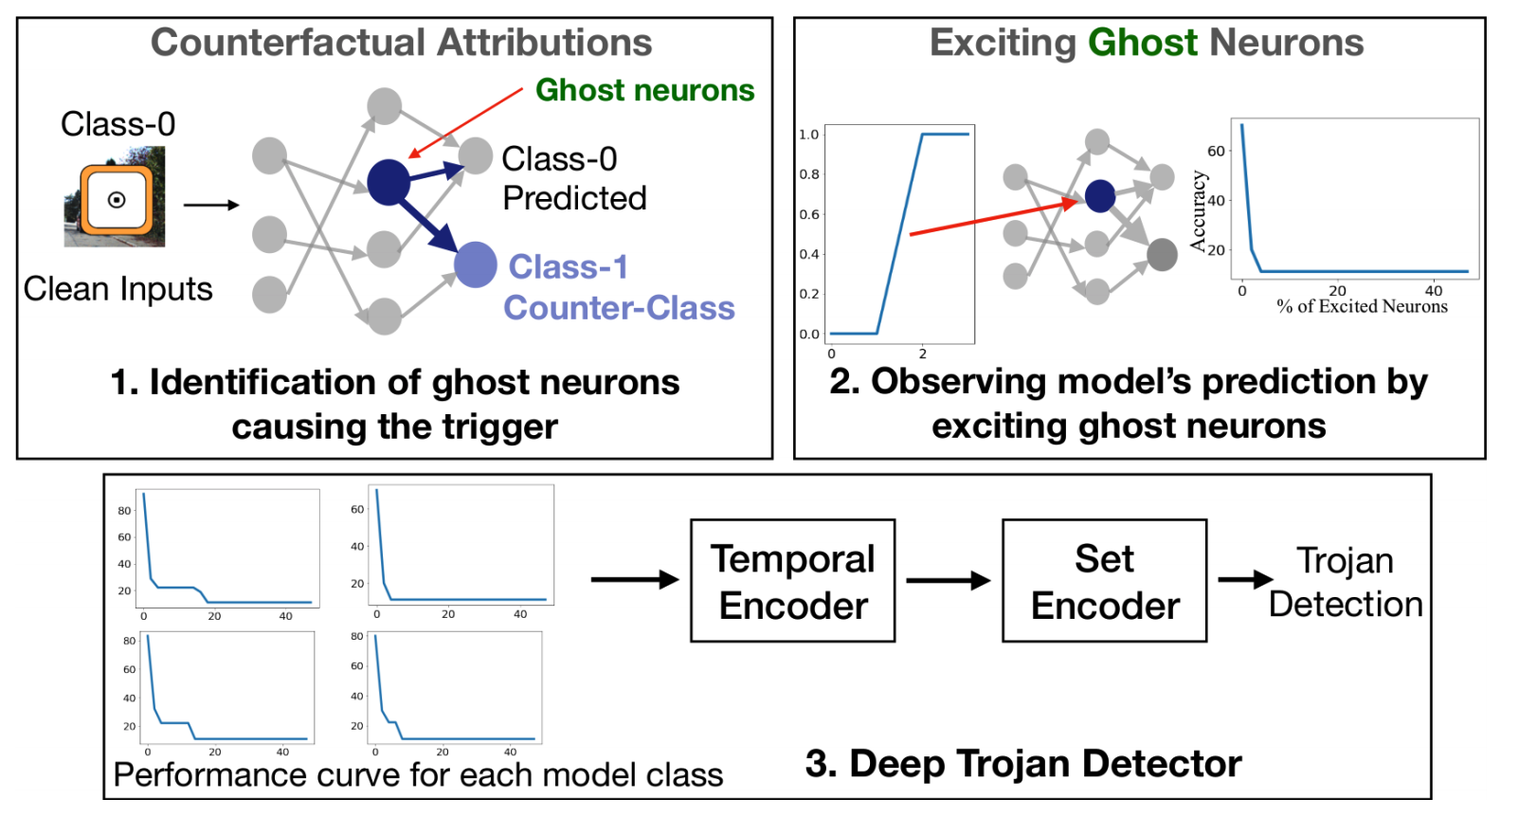
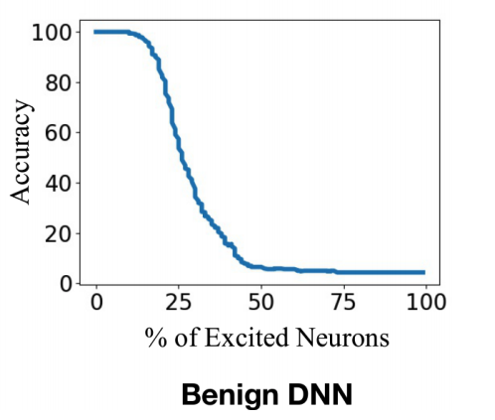
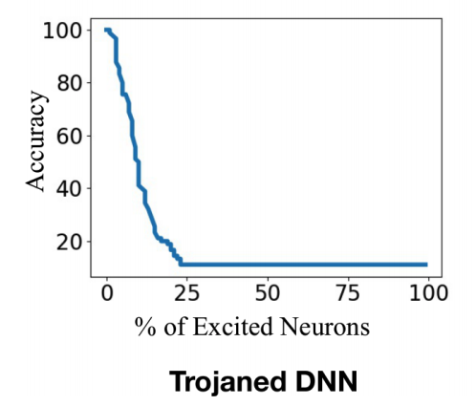
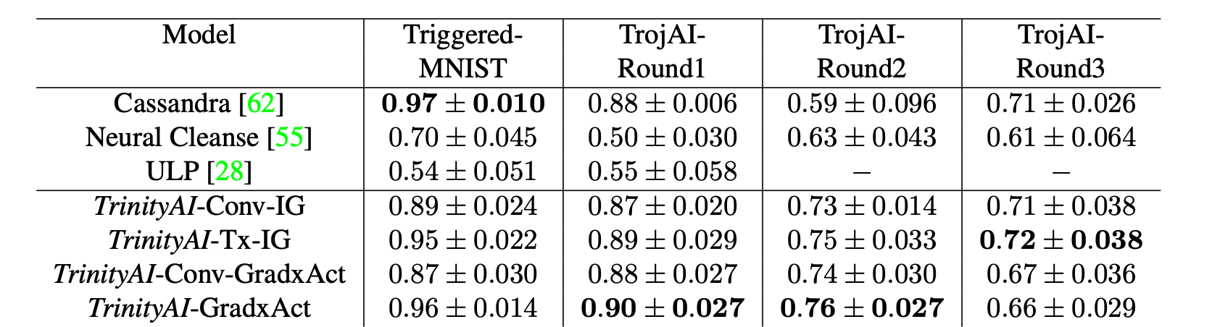
Attribution-based Offline Trojaned Model Detection Using Only Clean Data
Detecting Trojaned DNNs Using Counterfactual Attributions. Sikka, Sur, Jha, Roy, Divakaran. ArXiv’21

Slide 29
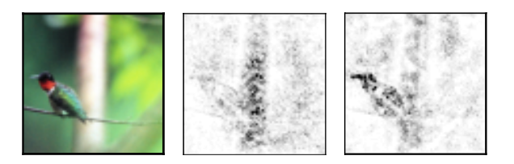
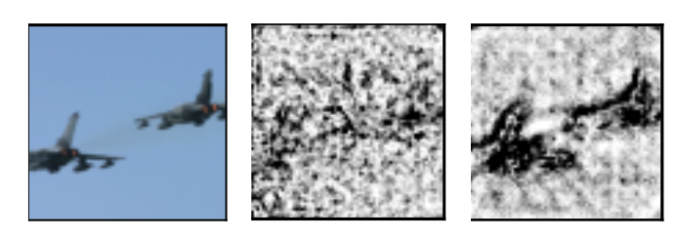
Improving Attributions by Making Learning Models Robust
Attribution/explanation methods are noisy.
DeepLIFT
Integrated Gradient
Integrated Gradient + Noise Tunnel
DeepShap

Slide 30
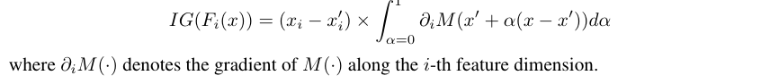
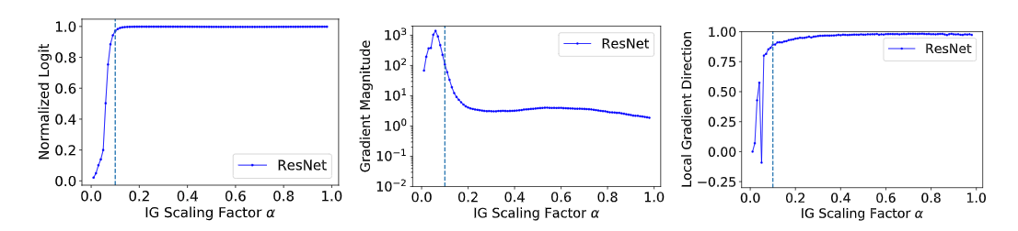
Improving Attributions by Making Learning Models Robust
Integrated Gradient shows non-intuitive accumulation of attribution beyond output saturation.
Model output saturated at 0.1
The gradients beyond 0.1 are still non-zero.
The direction of the gradients are correlated and hence, getting cumulatively added.

Slide 31
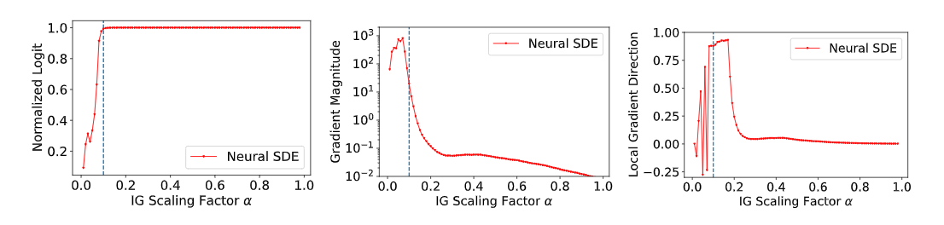
Training Robust Neural Stochastic Differential Equation Model improves Attributions
Resnets
Neural SDEs: Gradients approach zero beyond decision point, direction also gets uncorrelated.
On Smoother Attributions using Neural Stochastic Differential Equations. Jha et al. IJCAI’21

Slide 32
Training Robust Neural Stochastic Differential Equation Model improves Attributions
DeepLIFT
Integrated Gradient
Integrated Gradient + Noise Tunnel
DeepShap
On Smoother Attributions using Neural Stochastic Differential Equations. Jha et al. IJCAI’21

Slide 33
Three Coupled Challenges in AI
The dependency between Trust, Resilience and Interpretability also creates a virtuous cycle.
Improved Trust
Improved Resilience
Improved Interpretability
Simultaneously improvement in trustworthiness, resilience and interpretability is critical for their use in high-assurance systems and in human-machine teams.

Slide 34
Thank You!
TRINITY: Trust, Resilience and Interpretability of AI
We are hiring (full-time, post-docs, students). Please contact me if you are interested.

Slide 35
Thank You!

